Slide 1
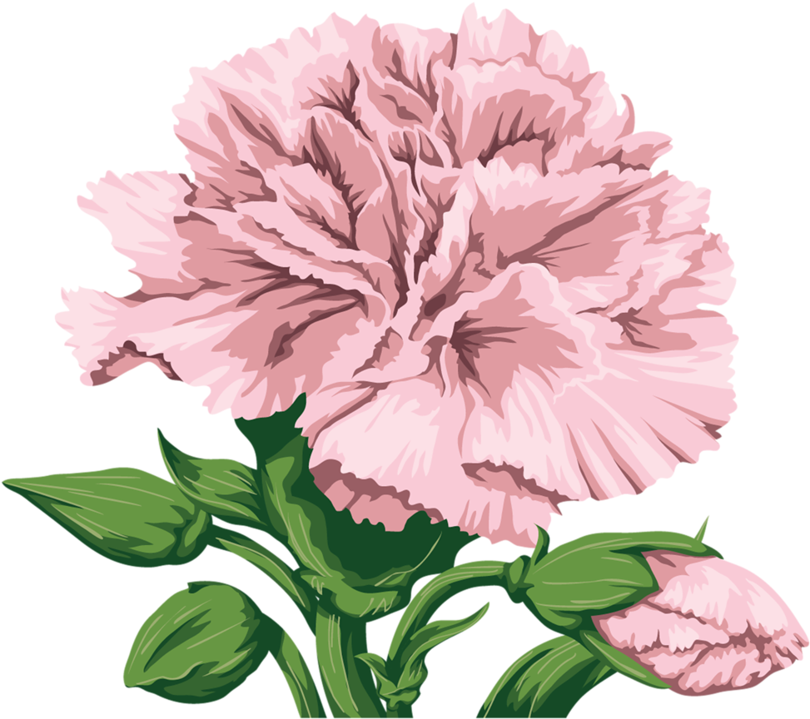
Tissue Paper Flower Craft
August 21, 2022

Slide 2
Review time!
Let’s review our last lesson on Spring and layers.

Slide 3
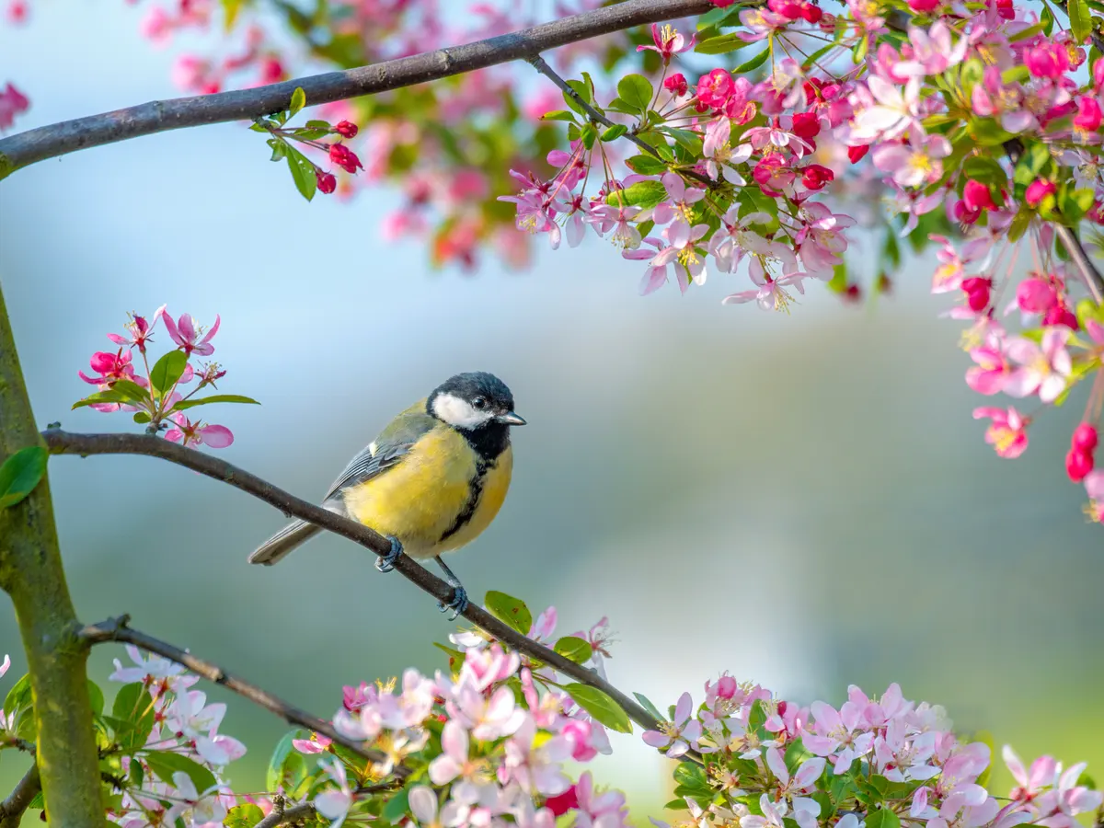
When is spring?
December - March
March - May
June - August
September - November

Slide 4
When is spring?
December - March
March - May
June - August
September - November

Slide 5
True or False: Before spring was called “spring,” it was called Lent
True
False

Slide 6
True or False: Before spring was called “spring,” it was called Lent
True
False

Slide 7
To make the apple appear above the tree, move the apple layer ____ the tree layer.
Above
Below
**Digital art question**

Slide 8
To make the apple appear above the tree, move the apple layer ____ the tree layer.
Above
Below
**Digital art question**
Putting the apple layer below the tree layer
Putting the apple layer above the tree layer

Slide 9
Lesson: Carnations

Slide 10
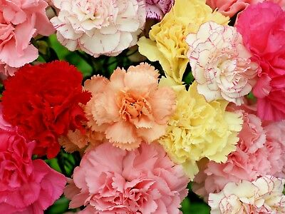
What are carnations?
Carnations are flowers that grow in the colors pink, white, red, yellow, and scarlet.
They symbolize love, purity, luck, and so much more.

Slide 11
How to make your own carnations

Slide 12
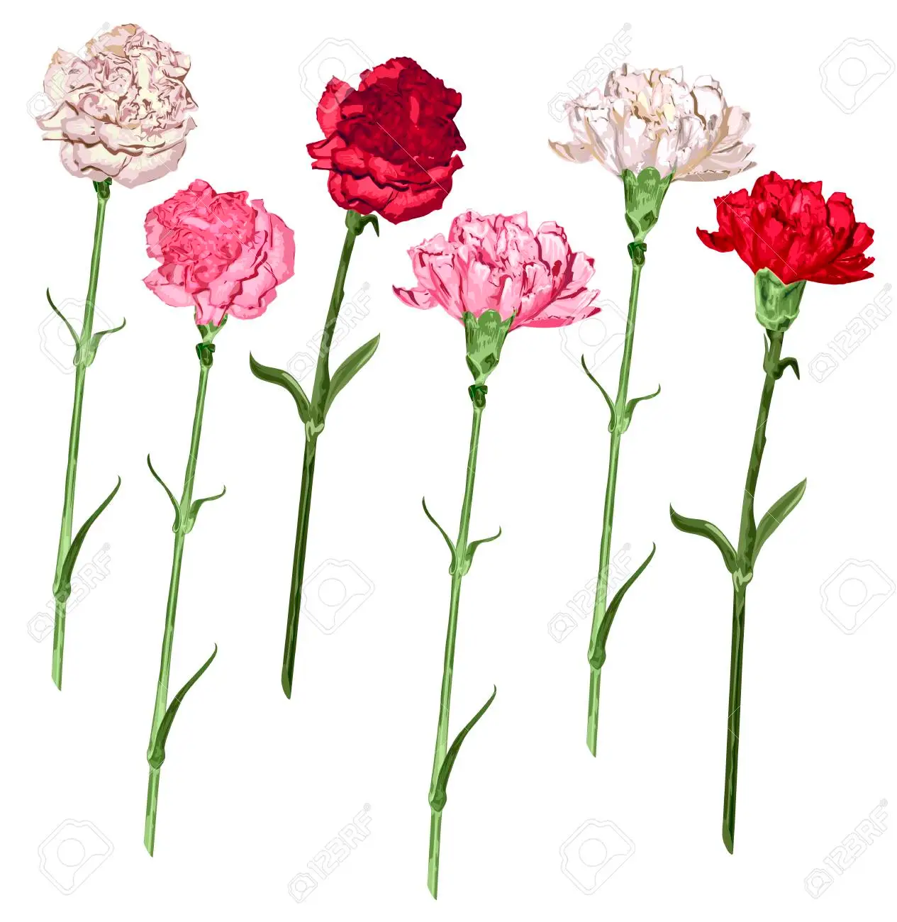
1) Choose the color of your carnation
Choose 6 sheets of tissue paper and stack them into 1 square.
You can choose 6 of the same or different colors.
Here are some carnation colors →

Slide 13
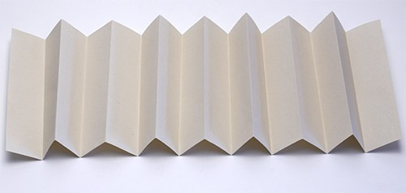
2) Fold the stack of papers
Fold your stack of papers like a fan.
Make sure you are folding all of the tissue papers at once.

Slide 14
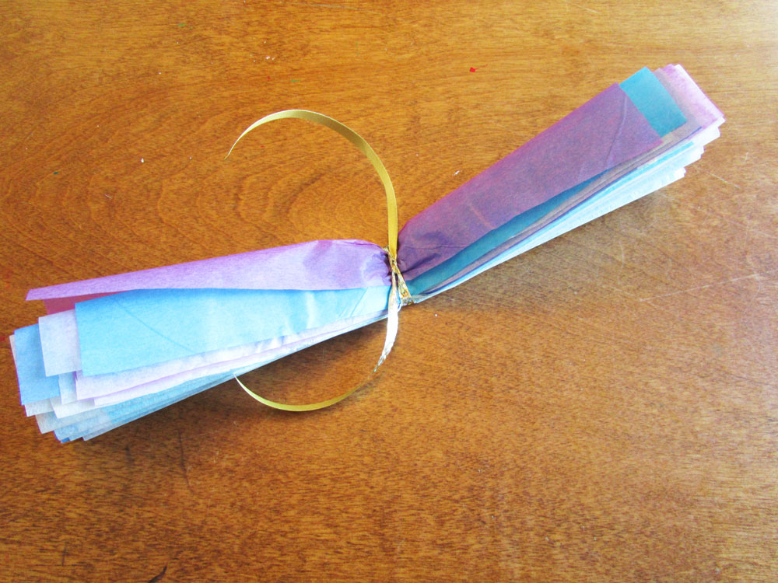
3) Wrap the middle with a pipe cleaner
Wrap the middle of your “fan” with a pipe cleaner.
Twist the pipe cleaner or tie it to secure it around the tissue papers.

Slide 15
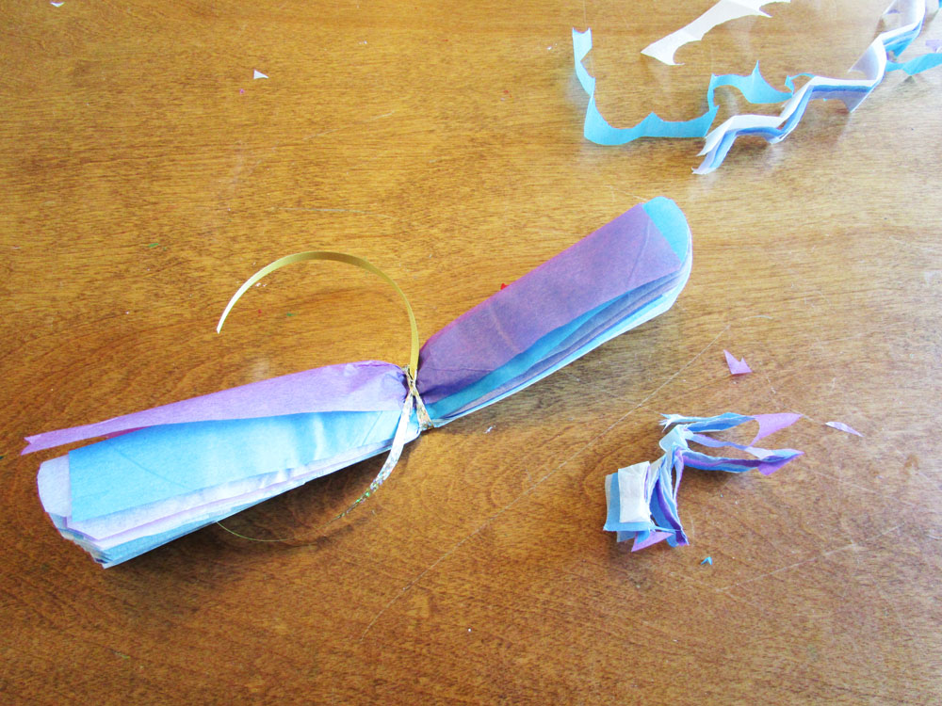
4) Trim the ends (optional)
Trim the ends with scissors.
You can make the sides round, pointy, or keep just the way it is.

Slide 16
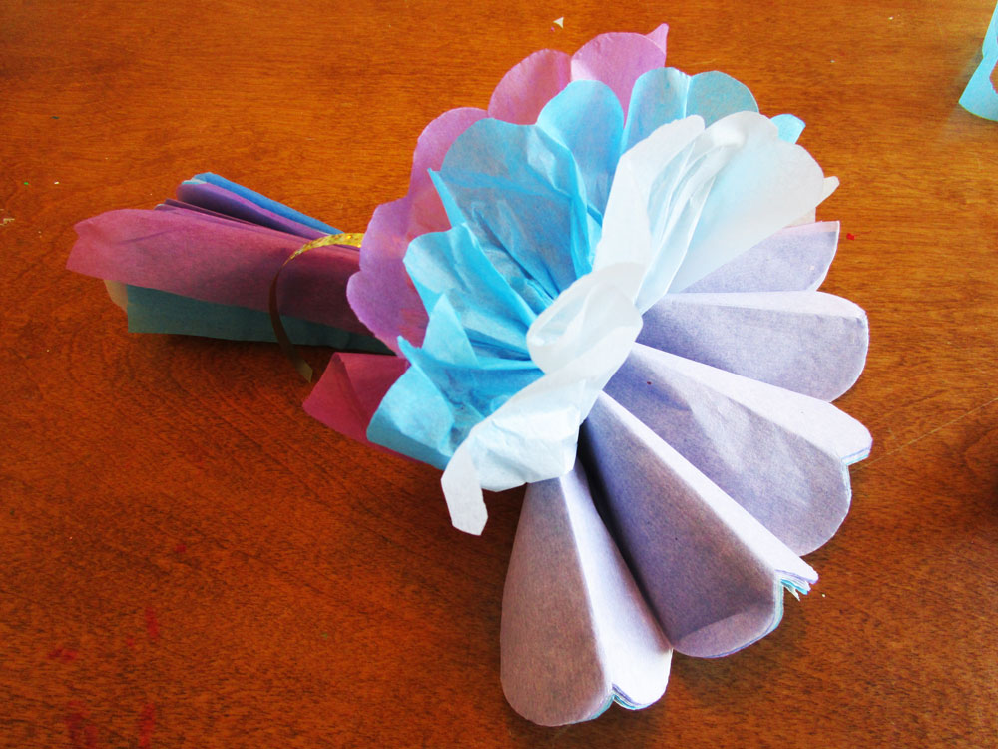
5) Peel the sheets carefully
Carefully peel each sheet.
Work one side at a time.
It’s okay if the paper rips a little!
Once you are done with one side, move onto the other side.

Slide 17
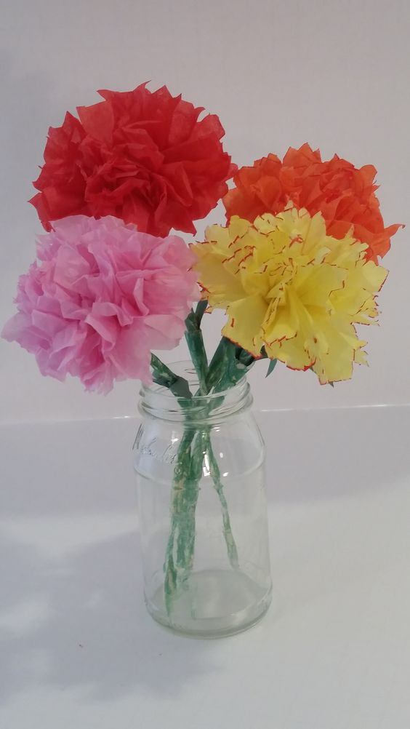
5) And you’re done!
You finished making your own carnation!
If you are done with one and we have time left over, feel free to make another one and make it a bouquet (a bunch of flowers).

