Slide 1
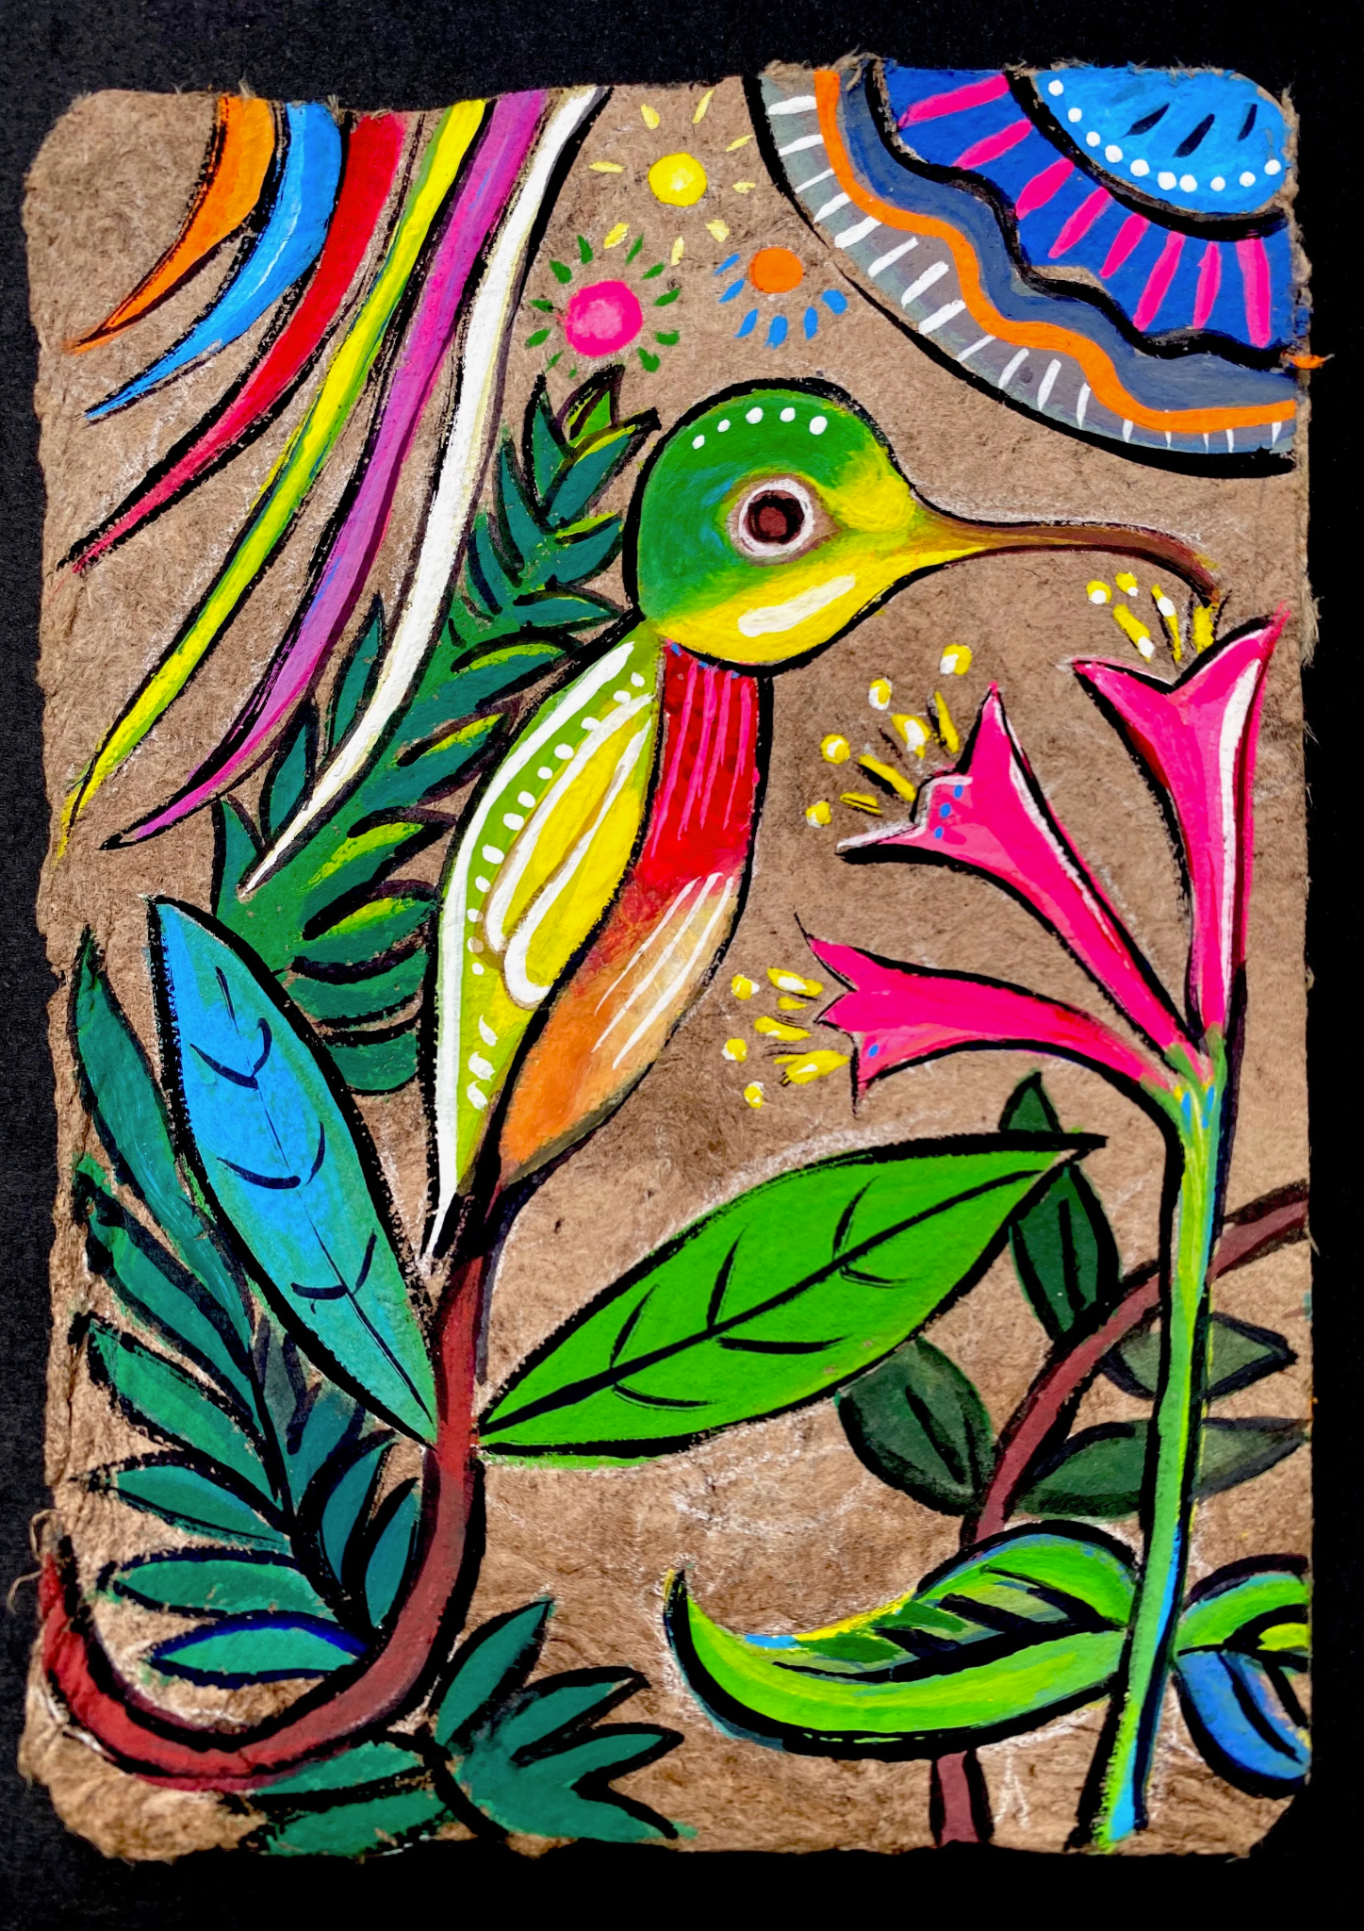
Amate Bark Painting
September 18, 2022

Slide 2
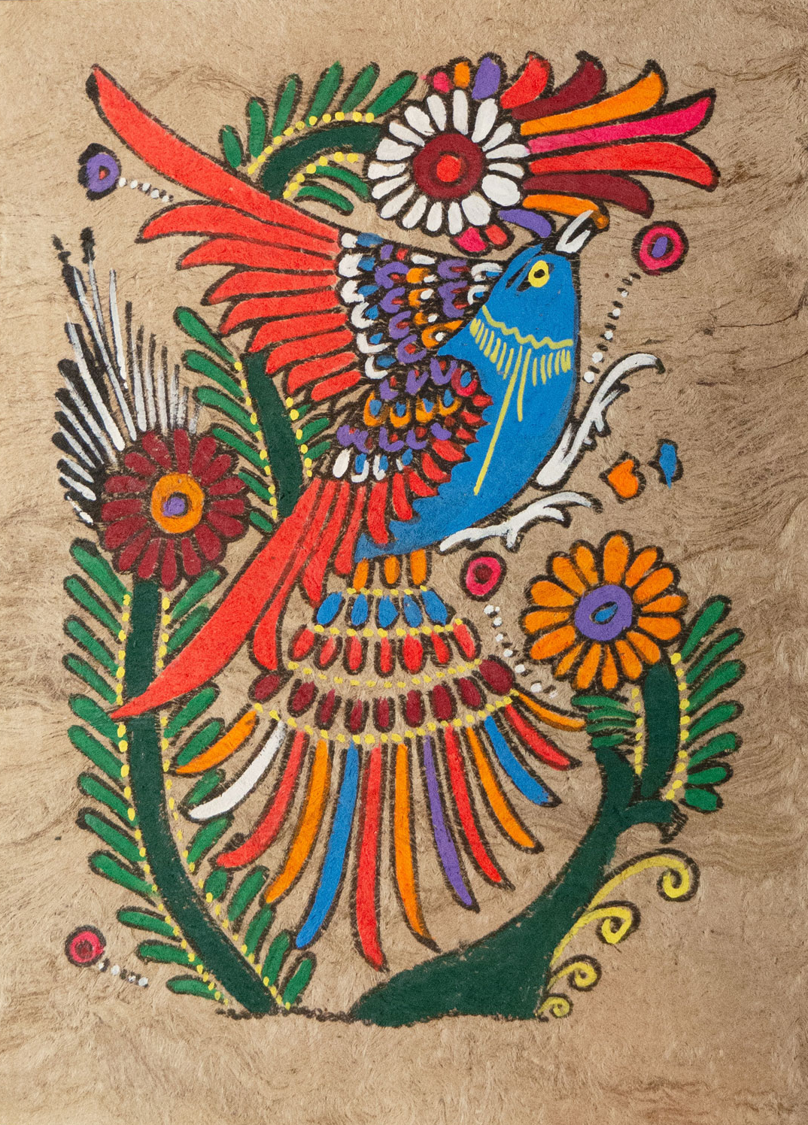
Lesson: Amate Paintings

Slide 3
Hispanic Heritage Month
Hispanic Heritage Month starts on September 15 and ends on October 15.
During this time, we celebrate the cultures and histories of the American Latino community.
This month is the anniversary of
independence for Costa Rica, El Salvador,
Guatemala, Honduras, and Nicaragua.

Slide 4
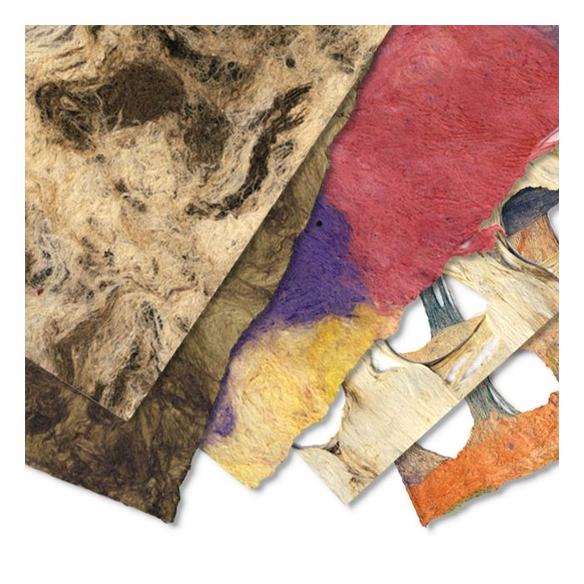
Amate Paintings
Amate painting is from Mexico.
Amate Bark Paper has been used for:
religious and legal texts
canvas for painting
Each sheet of this traditional Mexican paper is handmade from the bark of Amate, Nettle, and Mulberry trees.

Slide 5
Let’s make our own
Amate Painting!

Slide 6
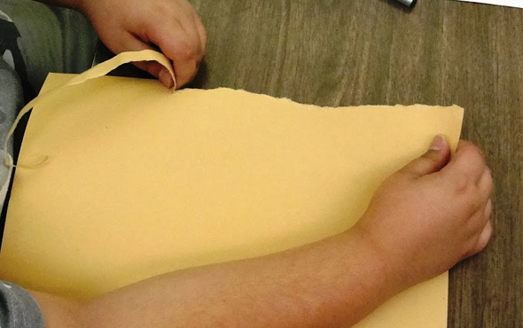
1. Rip the paper
Carefully and slowly rip the edges of the paper.
We are going to create a similar look of the original amate bark paper.

Slide 7
2. Draw a border
Using a black marker, draw a border around the paper.
Use lines, dots, triangles, squiggles, and any other shape.
Make sure that it isn’t too thick so we can draw something inside.

Slide 8
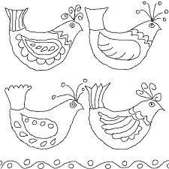
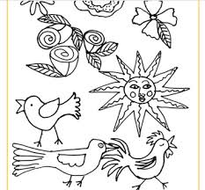
3. Draw inside the border
Draw 3 birds inside the borderr.
You can also draw flowers and the sun.

Slide 9
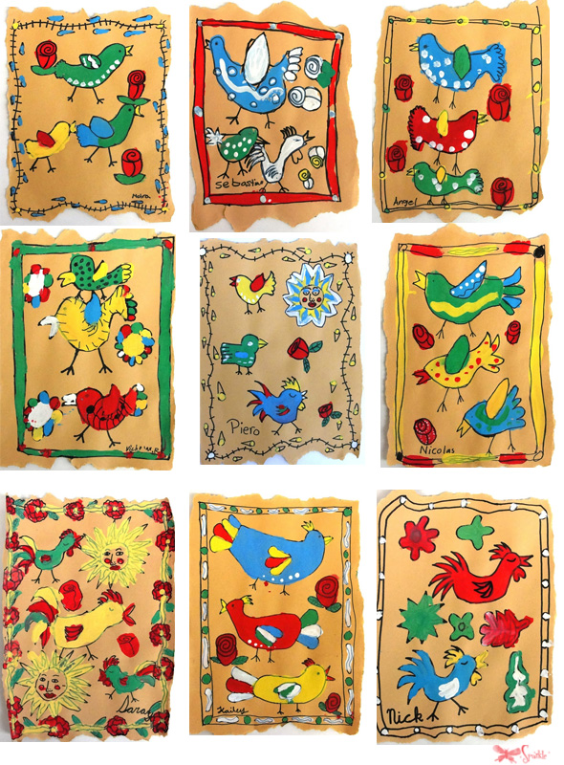
4. Paint!
Paint the birds, flowers, sun, and border.
We will only be using the colors red, white, yellow, green, and blue.
Add patterns! Use dots, squiggles, and lines.

